Slide 1
Two-sample Mendelian Randomization with Summary Data
Xinyi Pan
Master in Interdisciplinary Data Science
Duke University
April 22, 2022

Slide 2
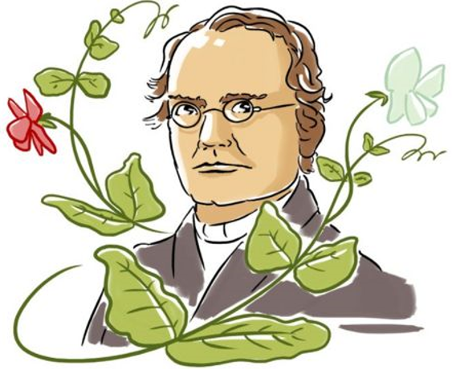
Mendel's Laws of Inheritance
Segregation: Alleles separate at meiosis, and a randomly selected allele is transmitted to offspring
Independent Assortment: Alleles for separate traits are transmitted independently of one another
The alleles an individual receives at the corresponding single-nucleotide polymorphism (SNP) are expected to be random w.r.t potential confounders and causal upstream of the exposure.

Slide 3
Mendelian Randomization: Three Core Assumptions
Unmeasured Confounders (U)
(2)
SNP
(G)
Exposure
(X)
Outcome
(Y)
(1)
(3)
Relevance assumption: SNP is associated with the exposure.
Independent assumption: SNP is NOT associated with confounding variables.
Exclusion restriction assumption: SNP is ONLY associated with the outcome through the exposure.
Notes:
A3: The instruments doesn’t influence the outcome through some pathway other than the exposure

Slide 4
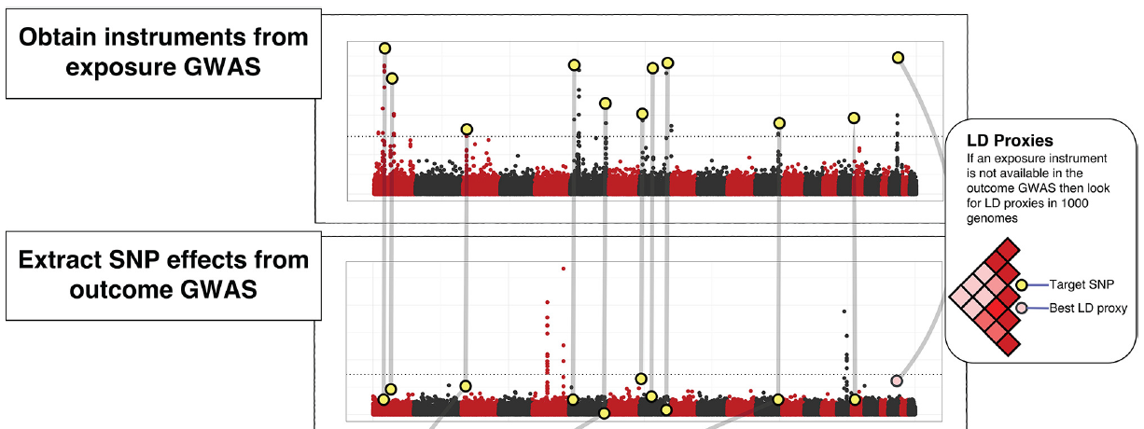
Workflow for Performing Two-Sample MR
Objective: Infer the causal effect of the exposure on the outcome
Step 1
Step 2

Slide 5
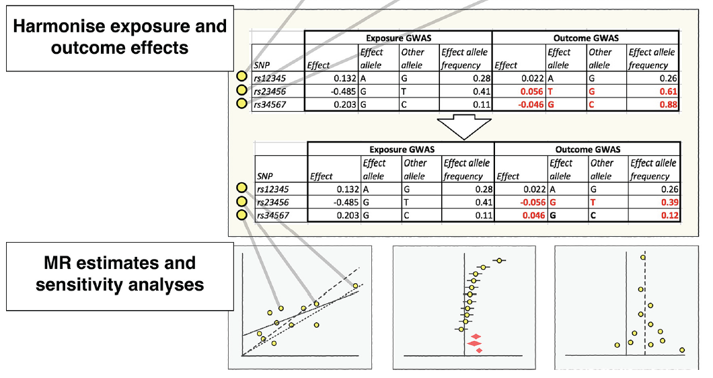
Workflow for Performing Two-Sample MR
Objective: Infer the causal effect of the exposure on the outcome
Step 3
Step 4

Slide 6
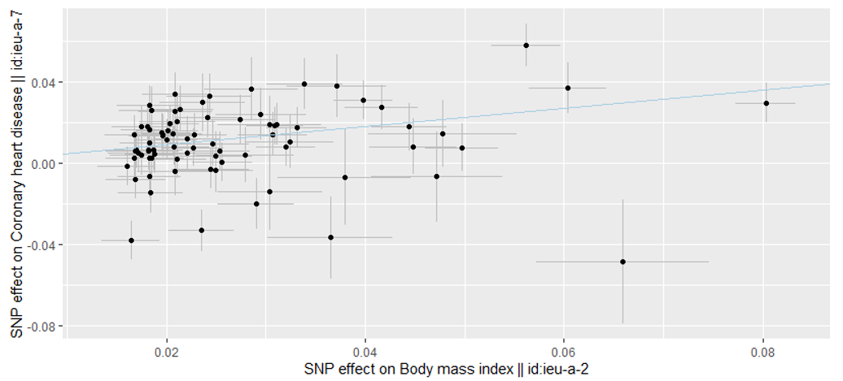
Case Study: Effect of body mass index on coronary heart disease

Slide 7
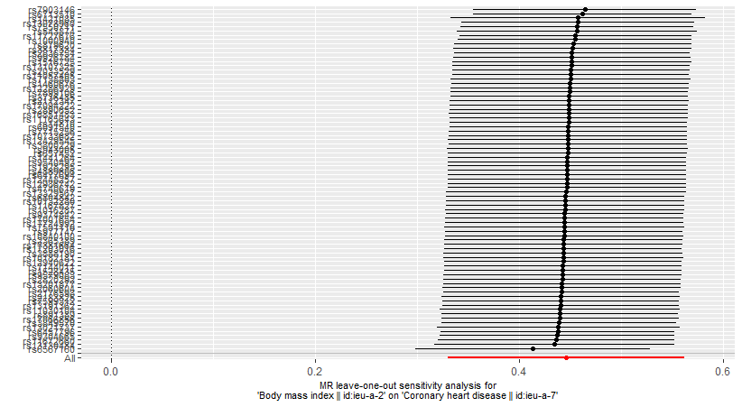
MR Leave-one-out-sensitivity Analysis: Body mass index on coronary heart disease

Slide 8
References
Ilona Miko: Gregor Mendel and the Principles of Inheritance Nature Education 2008. Available from: https://www.nature.com/scitable/topicpage/gregor-mendel-and-the-principles-of-inheritance-593/#
Sanderson, E., Glymour, M.M., Holmes, M.V. et al. Mendelian randomization. Nat Rev Methods Primers 2, 6 (2022). https://doi.org/10.1038/s43586-021-00092-5
Hemani, G., Zheng, J., Elsworth, B., Wade, K. H., Haberland, V., Baird, D., Laurin, C., Burgess, S., Bowden, J., Langdon, R., Tan, V. Y., Yarmolinsky, J., Shihab, H. A., Timpson, N. J., Evans, D. M., Relton, C., Martin, R. M., Davey Smith, G., Gaunt, T. R., & Haycock, P. C. (2018). The MR-Base platform supports systematic causal inference across the human phenome. eLife, 7, e34408. https://doi.org/10.7554/eLife.34408

Slide 9
Thank you!
Any questions?
Xinyi.pan@duke.edu
https://github.com/solaris-2578/TwoSampleMR-Demo

